Slide 1

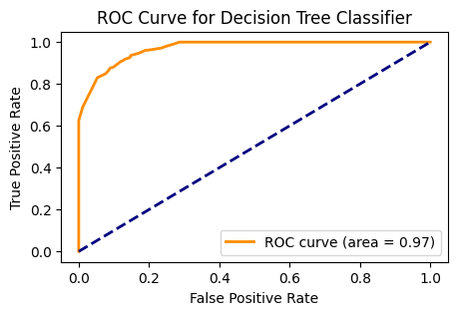
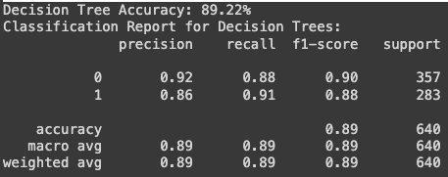
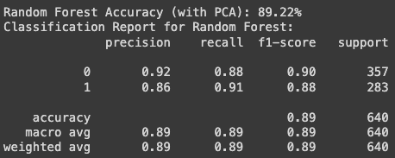
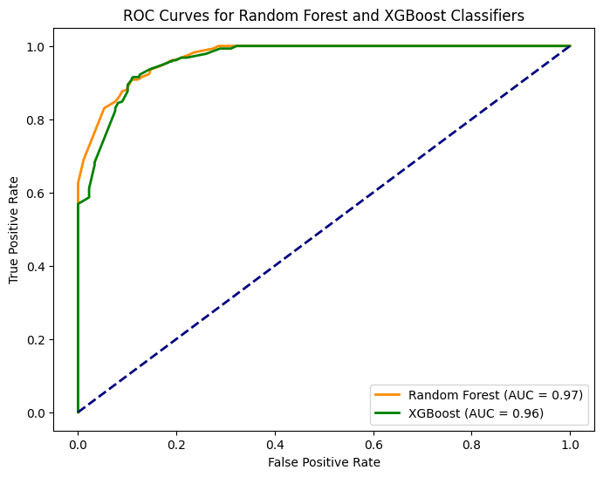
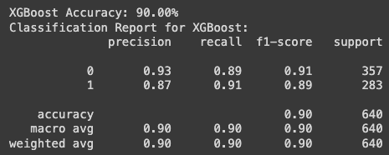
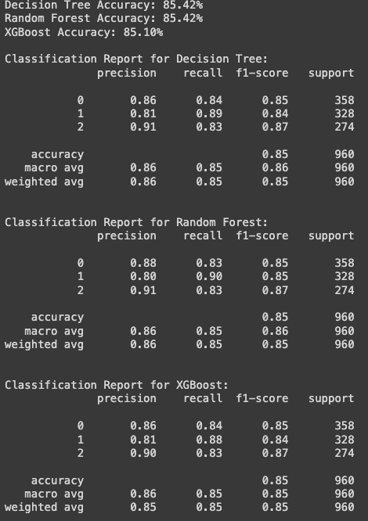
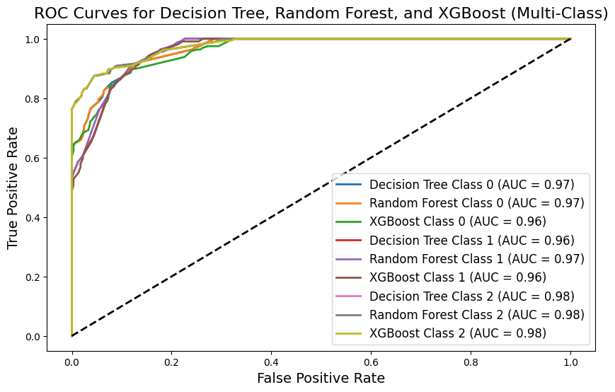
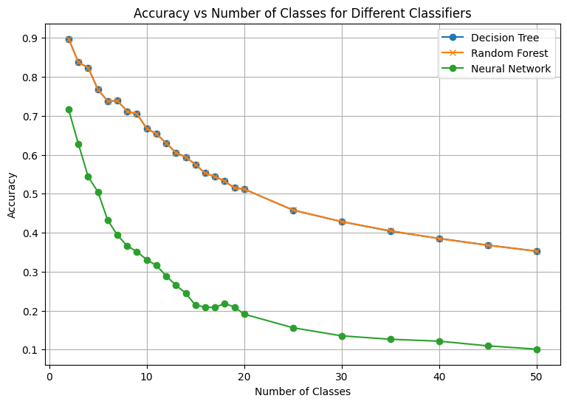
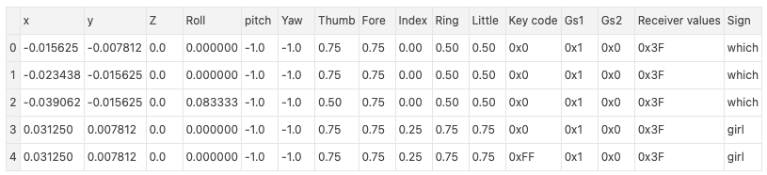
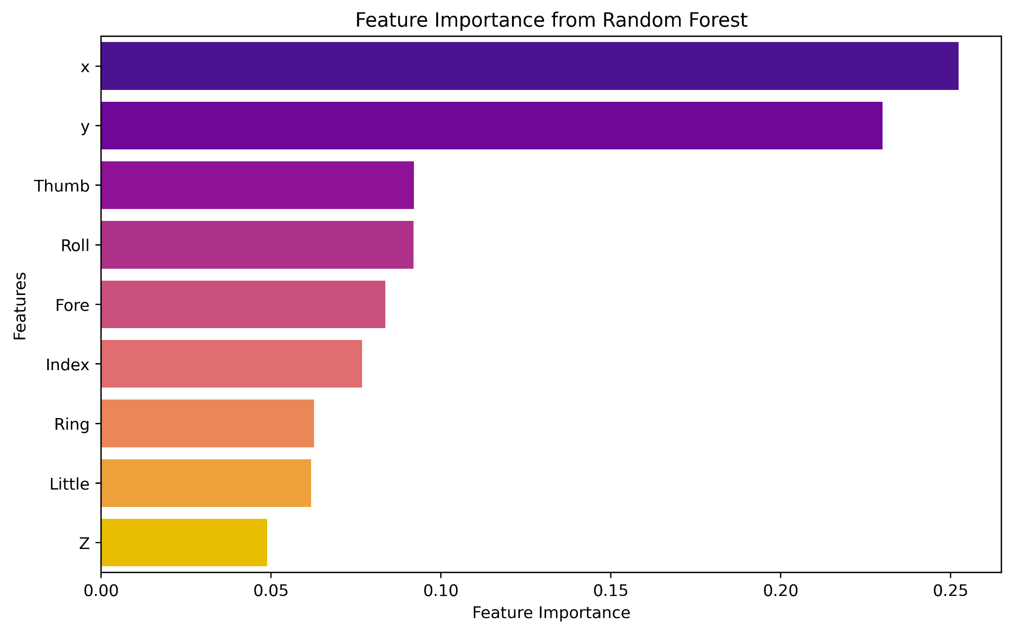
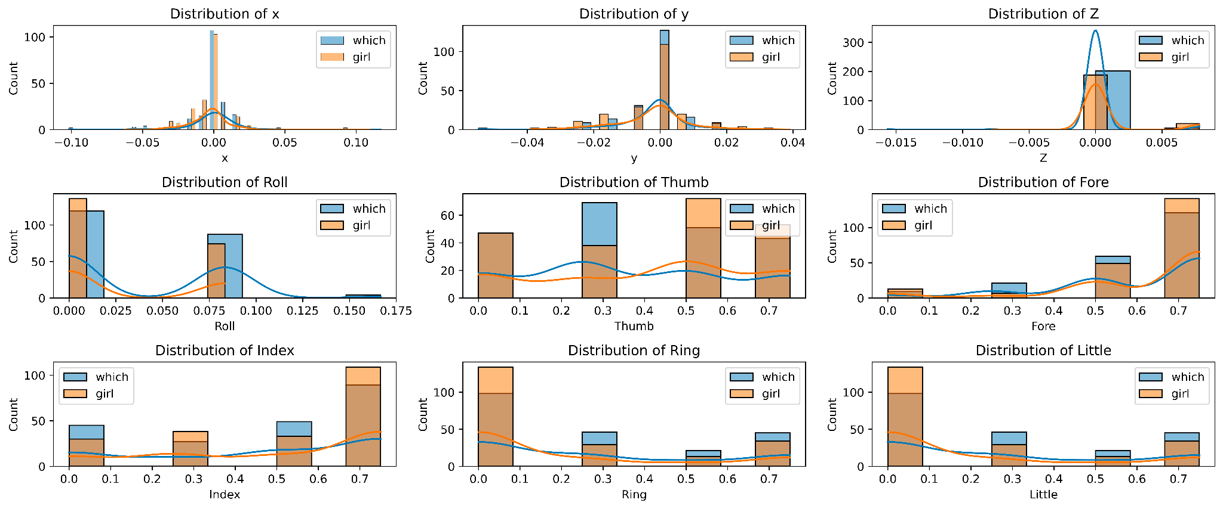
Auslan Recognition through Machine Learning
Samanvaya Arava
Mentors: Dr. Christelle Scharff
Seidenberg Graduate Research
Pace University, Seidenberg School of CSIS
Abstract
Sign language is the medium of communication for the hearing im-
paired people. It uses gestures instead of sound to convey meaning. It combines hand-shapes, orientation and movement of the hands, arms or body, facial expressions and lip-patterns for conveying messages. Our dataset comprises 95 signs, each with 1600 samples, collected over nine weeks from a native Auslan signer using sophisticated equipment. Methodology involves feature engineering, normalization, handling missing data, and exploring various models like Decision Trees, Random Forests, SVM, CNN, or RNN. Decision Trees and Random Forests showed better performance compared to Neural Networks across all classes.
Research Question
Building a machine learning model to recognize Australian Sign Language (Auslan) signs.
Related Work
The initial studies concentrate on computer vision techniques, utilizing methods like edge detection, wavelet transforms, and machine learning (e.g., K-Nearest Neighbors) to identify sign language gestures. Despite showing promise, these methods have limitations such as sensitivity to noise, the impact of wavelet selection, and dataset biases. Consequently, further research is needed to enhance these techniques. Meanwhile, a separate set of studies investigates novel technologies such as PowerGloves and RF sensing for sign language recognition. PowerGloves, equipped with sensors, offer precise hand movement tracking, while RF sensing captures gestures without cameras or physical contact. These studies showcase ongoing efforts to explore diverse technological avenues for improving sign language recognition, each addressing unique limitations of its approach.
Dataset
The data was captured over nine weeks from a native Auslan signer using sophisticated equipment, including Fifth Dimension Technologies (5DT) gloves and Ascension Flock-of-Birds magnetic position trackers. The data set contains 95 different signs. Each Sign has 1600 samples.
Methodology and EDA
Methodology involves feature engineering to identify key features, normalization for consistent scales, and handling missing data. Feature selection combines statistical methods and dimensionality reduction using correlation analysis and PCA. Model selection includes experimenting with Decision Trees, Random Forests, SVM, CNN, or RNN, with hyperparameter tuning and exploration of ensemble techniques. Training and validation are performed, and models are fine-tuned based on evaluation metrics. Error analysis identifies patterns in misclassifications, and class imbalance is addressed using oversampling, undersampling, or specialized algorithms. LIME is used for interpretability.
Results
Initially the the model were train with TWO CLASSES, then THREE classes and so on.
For both Binary classification xgboost performs better than Decision Trees (DT) and Random Forest (RF), with accuracies 90.00%, 89.22% and 89.22% respectively.
For Three-Class classification DT and RF perform similar and better than xgboost (85.42%, 85.42% and 85.10%).
When all classes are trained
the Decision Tree and Random
Forest perform better than Neural
Network
Conclusion & Future Work
This study contributes to advancing the development of Auslan sign recognition using machine learning techniques. Through rigorous experimentation and analysis, it was observed that Decision Trees and Random Forests outperformed Neural Networks in recognizing Auslan signs when trained across all classes. However, the study acknowledges the complexity inherent in sign language recognition, with challenges such as noise sensitivity, dataset biases, and the impact of feature selection. Future research should focus on refining models to mitigate these challenges and exploring hybrid approaches that combine the strengths of different machine learning techniques.
References
Kadous, M.W., Sammut, C. Classification of Multivariate Time Series and Structured Data Using Constructive Induction. Mach Learn 58, 179–216 (2005). https://doi.org/10.1007/s10994-005-5826-5
P. Q. Thang, N. T. Thuy and H. T. Lam, "The SVM, SimpSVM and RVM on sign language recognition problem," 2017 Seventh International Conference on Information Science and Technology (ICIST), Da Nang, Vietnam, 2017, pp. 398-403, doi: 10.1109/ICIST.2017.7926792.
S. Z. Gurbuz et al., "American Sign Language Recognition Using RF Sensing," in IEEE Sensors Journal, vol. 21, no. 3, pp. 3763-3775, 1 Feb.1, 2021, doi: 10.1109/JSEN.2020.3022376.
Prasad, M.V.D. & Kishore, P.V.V. & Eepuri, Kiran & Anil Kumar, D.. (2016). Indian sign language recognition system using new fusion based edge operator. 88. 574-584.
K. Amrutha and P. Prabu, "ML Based Sign Language Recognition System," 2021 International Conference on Innovative Trends in Information Technology (ICITIIT), Kottayam, India, 2021, pp. 1-6, doi: 10.1109/ICITIIT51526.2021.9399594.
Kumar, Dr.S.Saravana. (2020). Sign Language Recognition Using Machine Learning. International Journal of Pure and Applied Mathematics.

